Slide 1


QUALITY OF LIFE IN CANADA
ANALYSIS
By: Emmanuel Popoola

Slide 2

TABLE OF CONTENTS
1
Good Governance Analysis
2
Mental Health Analysis

Slide 3

DISCRIMINATION AND UNFAIR TREATMENT
GOOD GOVERNANCE
Notes:
It is important to note that these data were taken in 2020 and so the figures and reality may be different now.

Slide 4
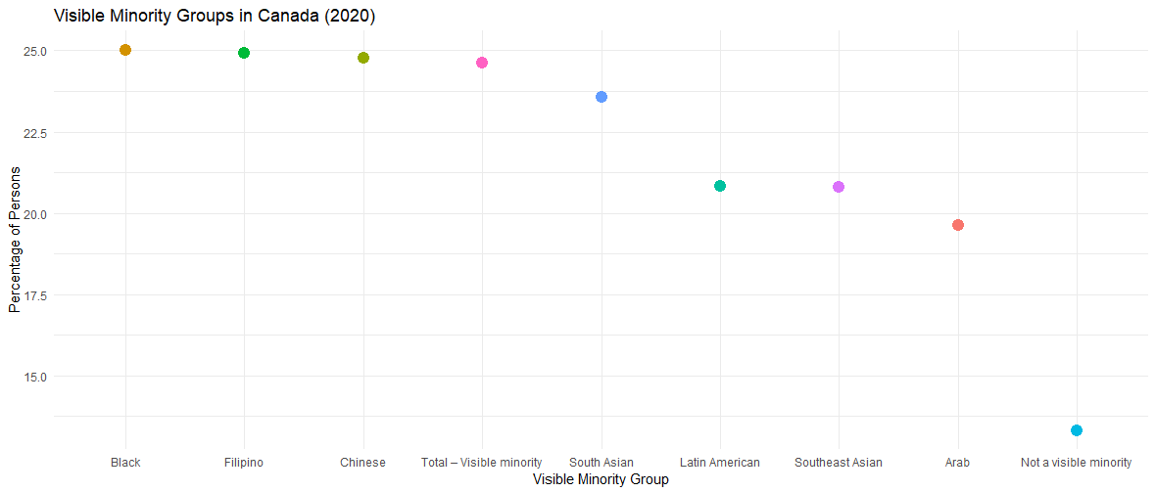
VISIBLE MINORITY GROUPS IN CANADA
Black, Filipino, and Chinese individuals reported the highest percentages of discrimination, exceeding 20%
“Not a visible minority" group reported the lowest levels of discrimination
With this, targeted policies and interventions to address inequalities and promote inclusion can be made.

Slide 5
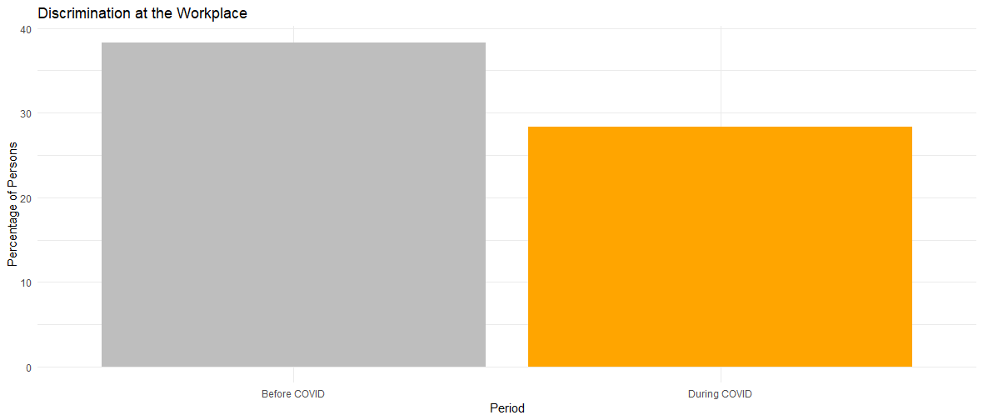
DISCRIMINATION IN THE WORKPLACE
Over 43% of persons experienced workplace discrimination before COVID-19
Since the beginning of COVID-19, it dropped to about 25%
This can be linked to increased remote work and reduced workplace interactions.

Slide 6
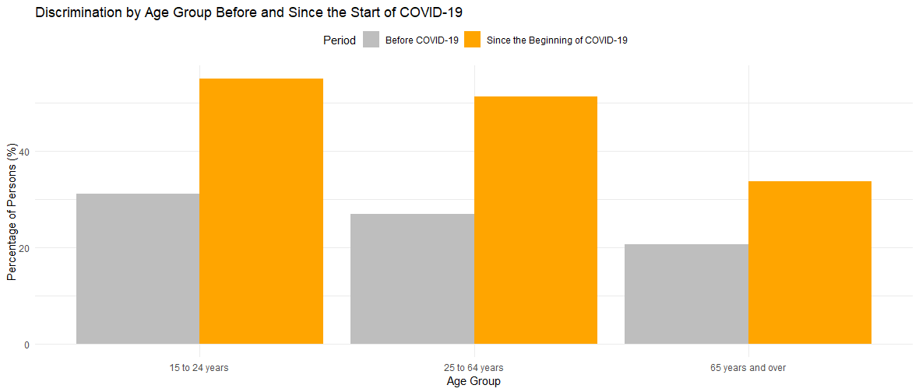
DISCRIMINATION BY AGE GROUP
All three age groups reported an increase in discrimination since the start of COVID-19.
65 years and over age group reported the lowest discrimination.
The COVID-19 pandemic led to rises in hate speech, racism, and stigmatization of certain populations

Slide 7
DEMOGRAPHIC PERSPECTIVE
ON
MENTAL HEALTH

Slide 8
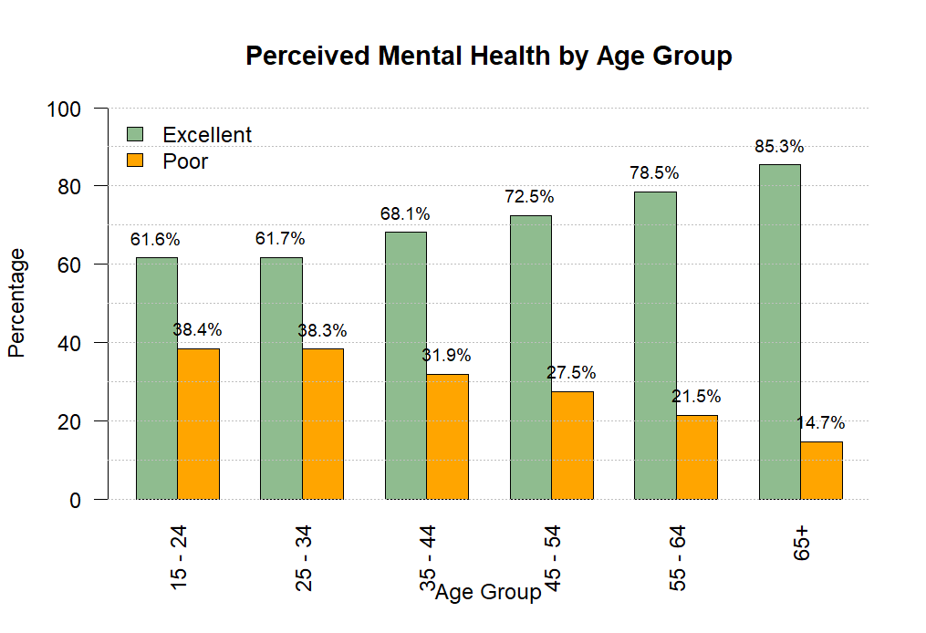
The graph shows that perception of excellent mental health improves with age, increasing from 61.6% in the 15–24 age group to 85.3% in individuals aged 65 and above.
This suggests a link between aging and better mental health, likely due to greater emotional regulation. Older adults may also have a more positive outlook on life and have developed effective coping mechanisms over time
Key Insights for Policy/intervention
Young adults could benefit from targeted mental health resources and programs to address stressors in early life stages.

Slide 9

THANK YOU

